Slide 1
Complexity-Optimized Algorithms for Large-scale Kernel Density Visualization

Slide 2
Introduction

Slide 3
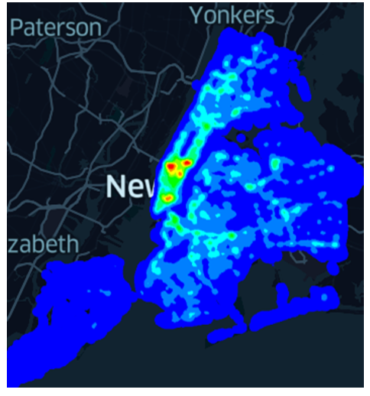
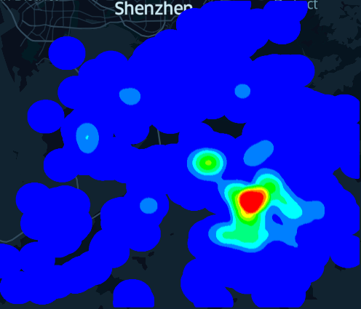
Why Data Visualization?
Find hidden patterns (e.g., hotspots) from a dataset.
Provide an intuitive way to understand a dataset (by visualizing it).
A heatmap (or hotspot map) for the New York traffic accident dataset
Hong Kong COVID-19 hotspot map

Slide 4
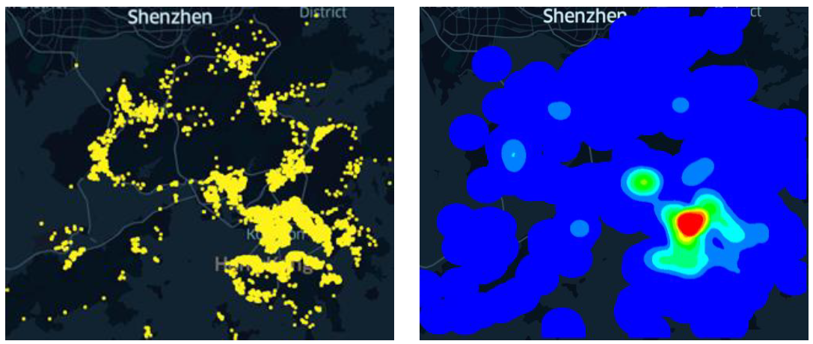
Why Kernel Density Visualization (KDV)?
KDV can provide better visualization quality compared with many traditional software tools.
Scatter plot of Hong Kong COVID-19 cases
Hotspot map of Hong Kong COVID-19 cases (based on KDV)

Slide 5
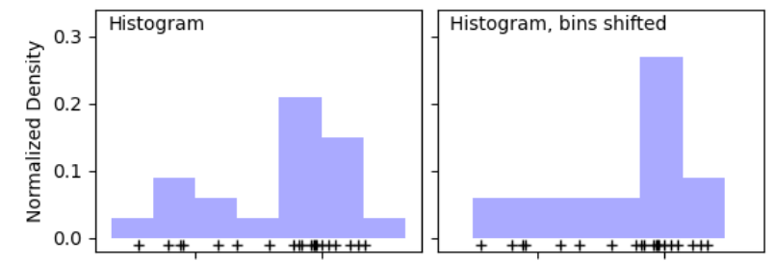
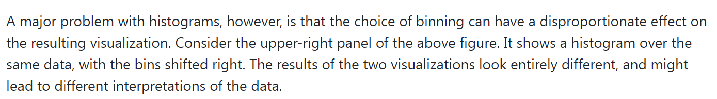
Why Kernel Density Visualization (KDV)?
KDV can provide better visualization quality compared with many traditional software tools.

Slide 6
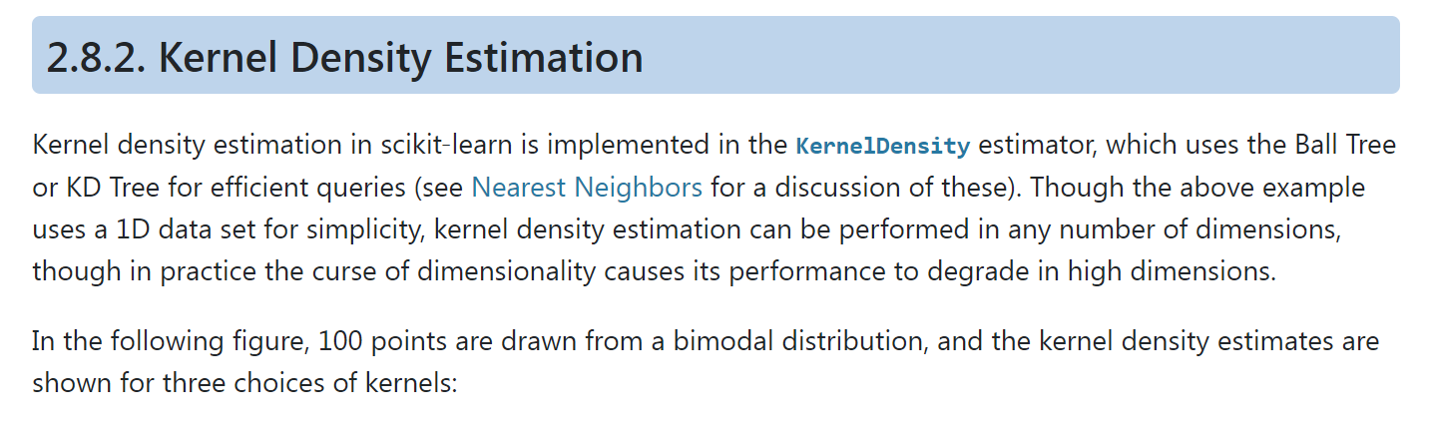
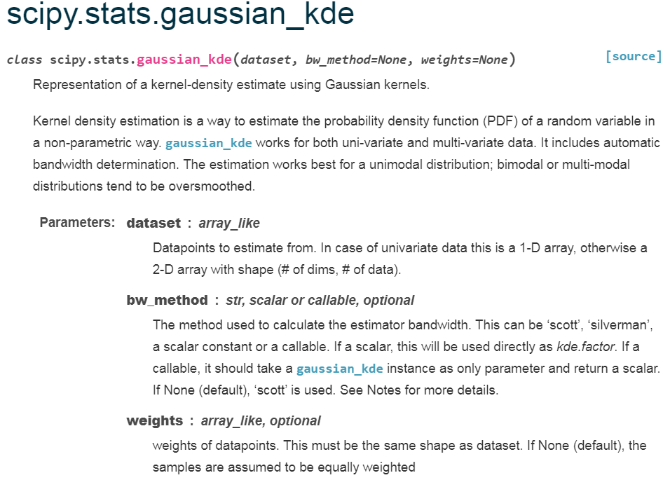
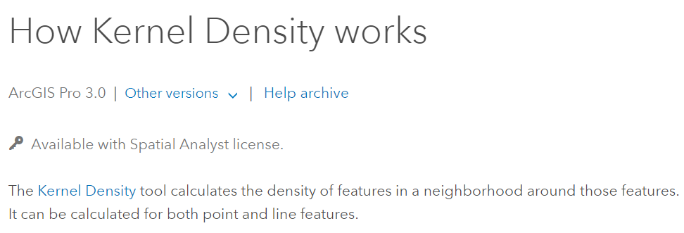
Why Kernel Density Visualization (KDV)?
A de facto method
Supported by many software packages
Scikit-learn
ArcGIS
Scipy

Slide 7
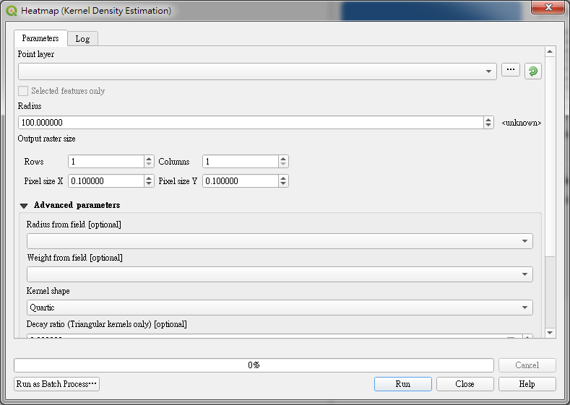
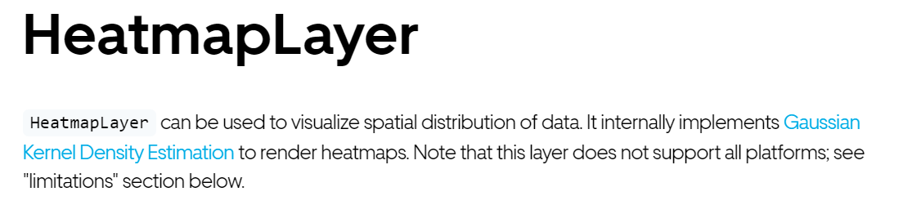
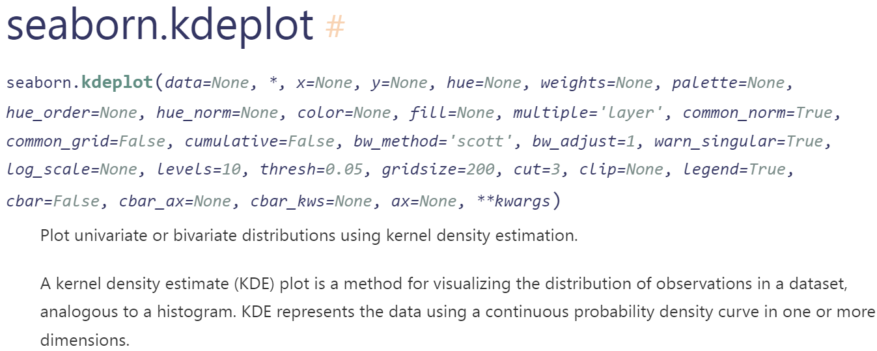
Why Kernel Density Visualization (KDV)?
A de facto method
Supported by many software packages
Deck.gl
QGIS
Seaborn

Slide 8
Kernel Density Visualization (KDV)

Slide 9
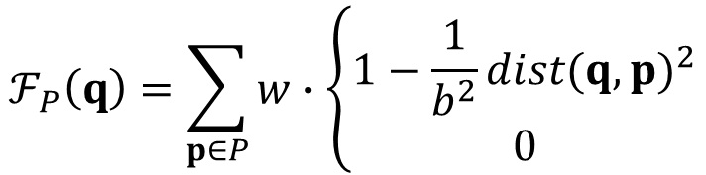
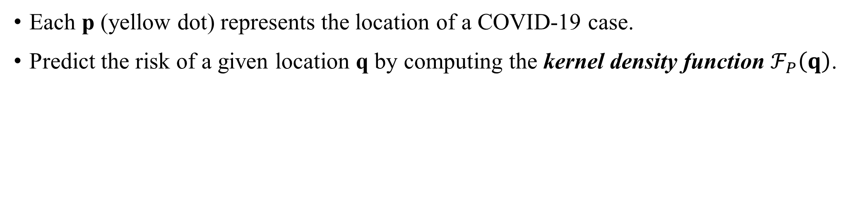
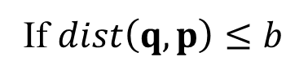
What is KDV?
Each p (yellow dot) represents the location of a COVID-19 case.
Predict the risk of a given location q by computing the kernel density function $ℱ_{P}\left(q\right)$.
2D pixel
weighting
Euclidean distance
$$ℱ_{P}\left(q\right)=\sum_{p∈P}{w}∙\left\{\begin{matrix}1−\frac{1}{b^{2}}{dist(q,p)}^{2} \\ 0\end{matrix}\right.$$
If $dist\left(q,p\right)≤b$
Otherwise
dataset
bandwidth

Slide 10
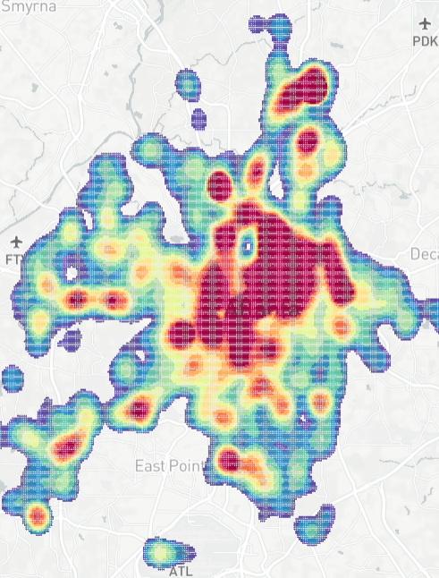
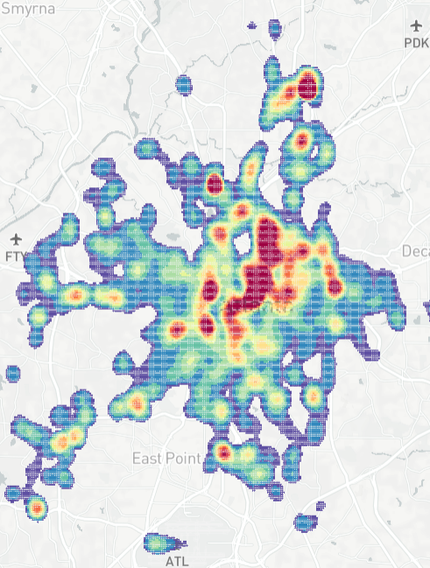
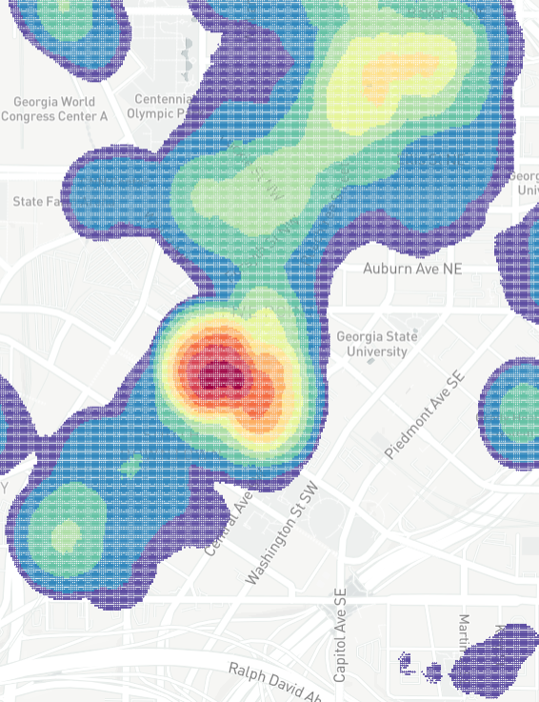
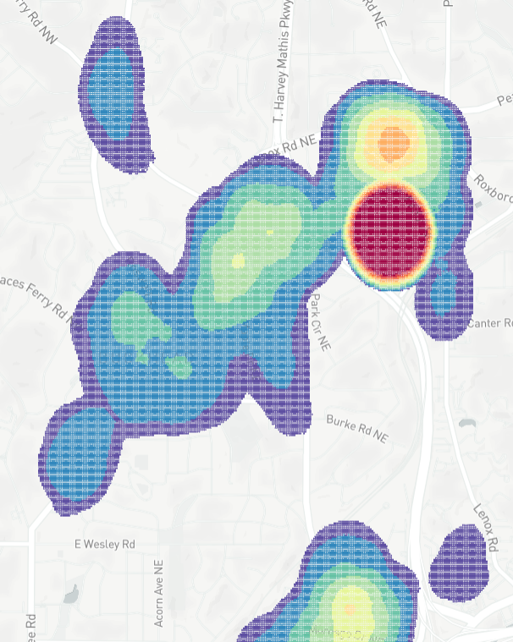
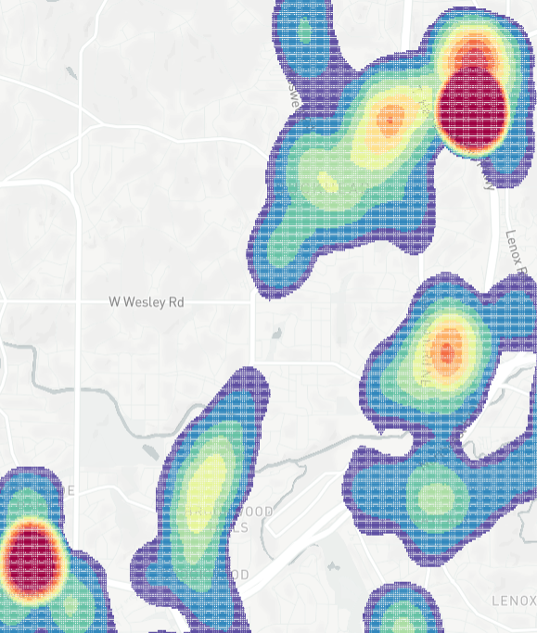





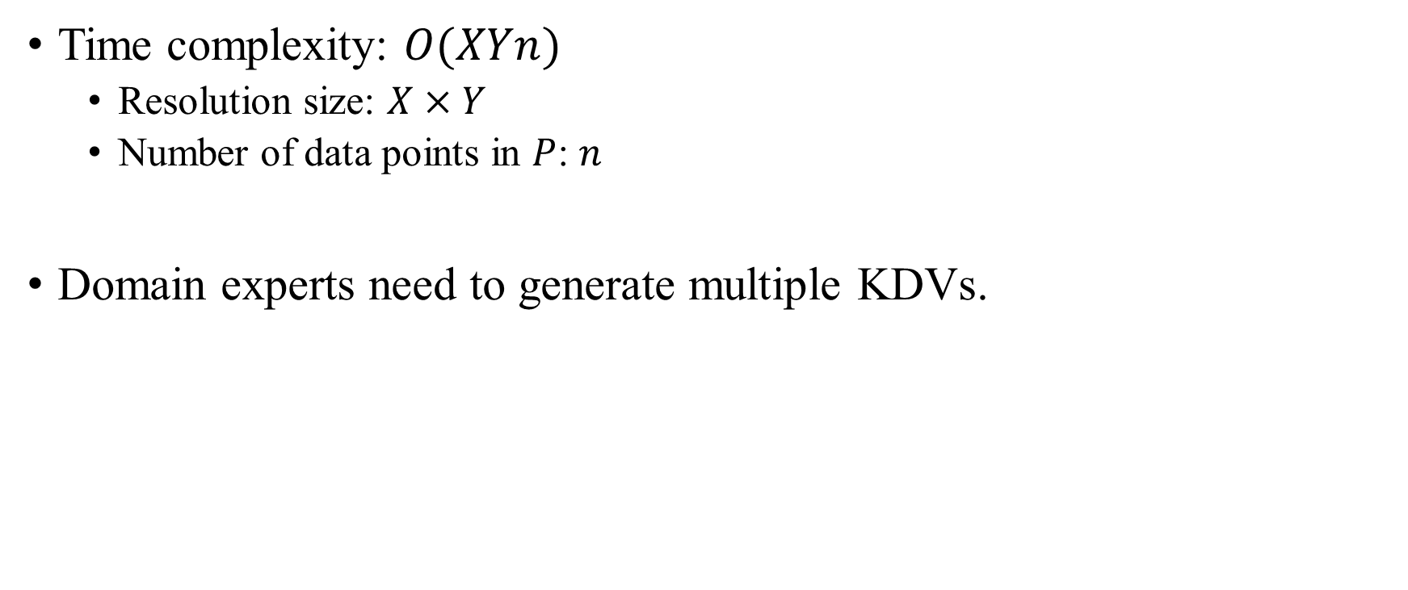
KDV is Slow!
Time complexity: $O(XYn)$
Resolution size: $X×Y$
Number of data points in $P$: $n$
Domain experts need to generate multiple KDVs.
B
Bandwidth
selection
Zoom in
Panning
Zoom out
Many exploratory
operations
(e.g., filtering)

Slide 11
KDV is Slow!
Complaints:
Gan et al. [1] “...the total runtime cost of density estimation is quadratic in dataset size...”
Gramacki et al. [2] “However, many (or even most) of the practical algorithms and solutions designed in the context of KDE are very time-consuming with quadratic computational complexity being a commonplace.”
[1] Edward Gan and Peter Bailis. Scalable Kernel Density Classification via Threshold-Based Pruning. In SIGMOD 2017. 945–959.
[2] A. Gramacki. Nonparametric Kernel Density Estimation and Its Computational Aspects. Springer International Publishing 2017.

Slide 12
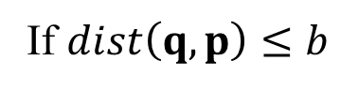
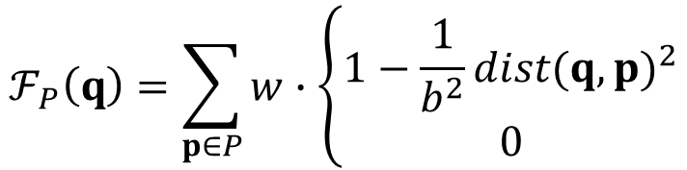
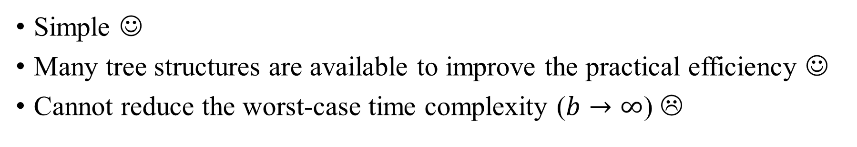
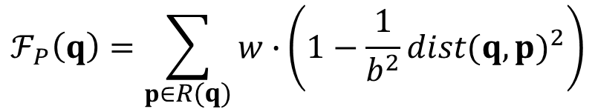
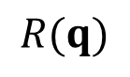
Range-Query-based Solution
$$ℱ_{P}\left(q\right)=\sum_{p∈P}{w}∙\left\{\begin{matrix}1−\frac{1}{b^{2}}{dist(q,p)}^{2} \\ 0\end{matrix}\right.$$
If $dist\left(q,p\right)≤b$
b
Otherwise
q
$$ℱ_{P}\left(q\right)=\sum_{p∈R(q)}{w∙}\left(1−\frac{1}{b^{2}}{dist(q,p)}^{2}\right)$$
$$R(q)$$
Simple ☺
Many tree structures are available to improve the practical efficiency ☺
Cannot reduce the worst-case time complexity ($b→∞$) ☹

Slide 13
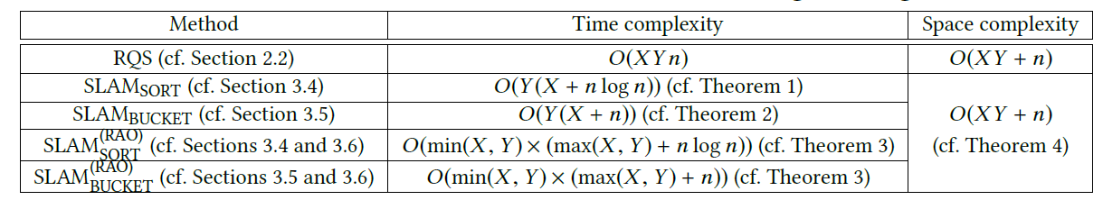
Our Solution: SLAM
The first work for generating a single KDV that can:
Reduce the worst-case time complexity ☺
Retain the same space complexity ☺
Achieve one to two-order-of-magnitude speedup for supporting KDV, using large-scale datasets ☺

Slide 14
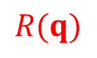
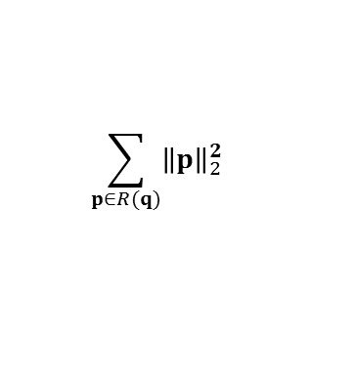
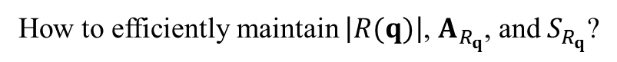
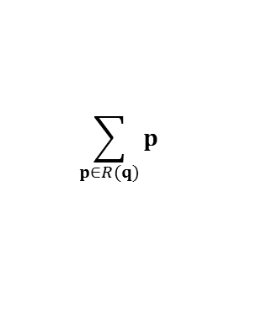
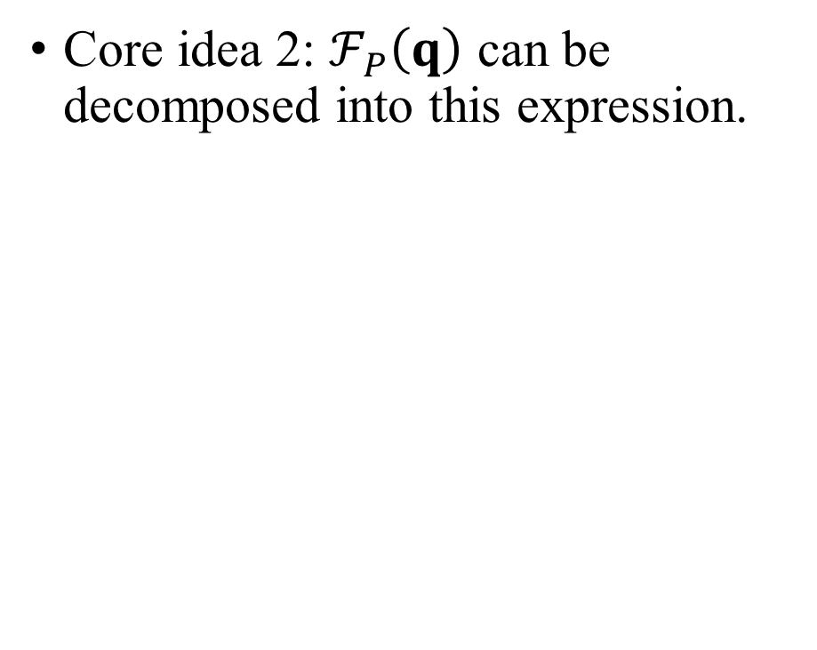
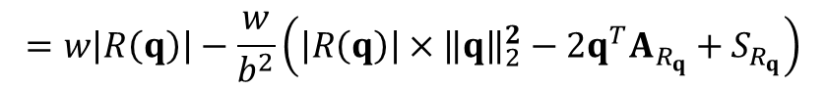
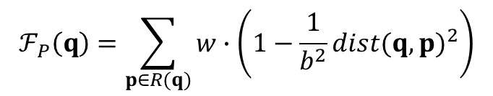
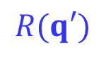
Core Ideas of SLAM
Core idea 1: two consecutive pixels can share many data points (white circles) in the range set.
Core idea 2: $ℱ_{P}\left(q\right)$ can be decomposed into this expression.
$$ℱ_{P}\left(q\right)=\sum_{p∈R(q)}{w∙\left(1−\frac{1}{b^{2}}{dist(q,p)}^{2}\right)}$$
b
$$=w\left|R\left(q\right)\right|−\frac{w}{b^{2}}\left(\left|R\left(q\right)\right|×{\left\|q\right\|}_{2}^{2}−2q^{T}A_{R_{q}}+S_{R_{q}}\right)$$
q
q’
$$\sum_{p∈R(q)}{p}$$
$$\sum_{p∈R(q)}{{\left\|p\right\|}_{2}^{2}}$$
$$R(q)$$
$$R(q′)$$
Can we share computations between two consecutive pixels?
How to efficiently maintain $\left|R(q)\right|$, $A_{R_{q}}$, and $S_{R_{q}}$?

Slide 15
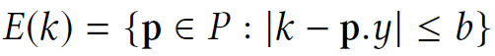
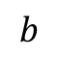
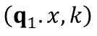
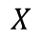
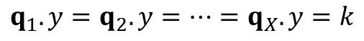
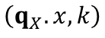
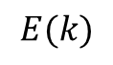
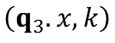
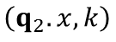
Envelope for A Row of Pixels
X
…
$$b$$
…
…
…
…
$$\left(q_{1}.x,k\right)$$
$$\left(q_{3}.x,k\right)$$
…
q₁
q₂
q_{X-1}
q_{X}
Y
$$E(k)$$
…
$$\left(q_{2}.x,k\right)$$
$$\left(q_{X}.x,k\right)$$
…
…
…
…
$$q_{1}.y=q_{2}.y=…=q_{X}.y=k$$
$$X$$
Use $O(n)$ time to find the envelope $E(k)$.

Slide 16
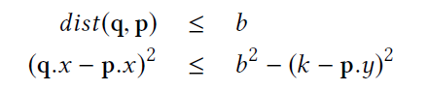
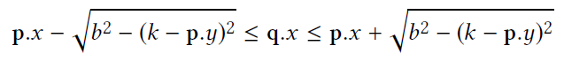
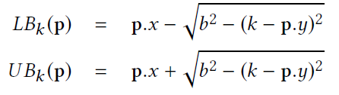
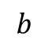
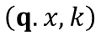
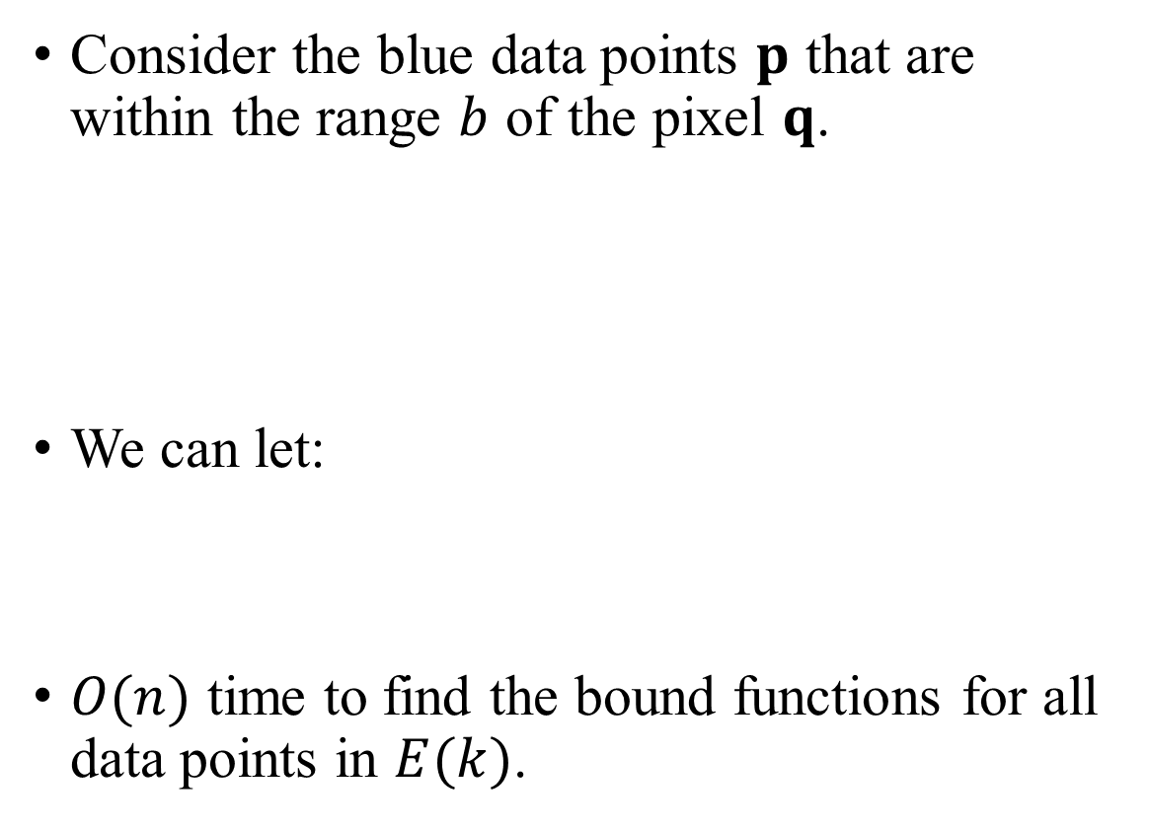
Lower and Upper Bound Functions
Consider the blue data points $p$ that are within the range $b$ of the pixel $q$.
We can let:
$O(n)$ time to find the bound functions for all data points in $E(k)$.
p₁
$$b$$
p₂
$$\left(q.x,k\right)$$
p₃
p₄

Slide 17
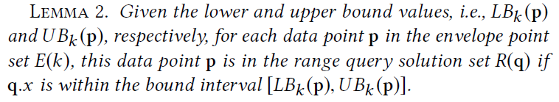
Range Search Problem = Interval Stabbing Problem
q.x
p₁
LB_{k}(p₁)
UB_{k}(p₁)
p₁
$$b$$
p₂
p₂
LB_{k}(p₂)
UB_{k}(p₂)
p₃
$$\left(q.x,k\right)$$
LB_{k}(p₃)
UB_{k}(p₃)
p₃
p₄
p₄
LB_{k}(p₄)
UB_{k}(p₄)
x-axis

Slide 18


Sorting-based Sweep Line Algorithm (SLAM_{SORT})
q_{i-1}.x
$$ℓ$$
q_{i}.x
q_{i+1}.x
p₁
LB_{k}(p₁)
UB_{k}(p₁)
p₂
LB_{k}(p₂)
UB_{k}(p₂)
q_{i-1}
p₃
q_{i}
q_{i+1}
LB_{k}(p₃)
UB_{k}(p₃)
p₄
LB_{k}(p₄)
UB_{k}(p₄)
p₅
LB_{k}(p₅)
UB_{k}(p₅)
x-axis
Sort the x-coordinates of the end points of all intervals with $O(n\log{n})$ time.
Use the sweep line $ℓ$ to maintain $\left|R(q)\right|$, $A_{R_{q}}$, and $S_{R_{q}}$ and calculate $ℱ_{P}\left(q\right)$ for each pixel $q$ with $O(X+n)$ time. (Refer to the paper for more details)
Overall time complexity for processing a row of pixels: $O(X+n\log{n})$.
SLAM_{SORT} takes $O(Y(X+n\log{n}))$ time ☺

Slide 19

Bucket-based Sweep Line Algorithm (SLAM_{BUCKET})
Can remove the sorting step (How? Refer to the paper [a] for more details).
SLAM_{BUCKET} takes $O(Y(X+n))$ time ☺
[a] Tsz Nam Chan, Leong Hou U, Byron Choi, Jianliang Xu: “SLAM: Efficient Sweep Line Algorithms for Kernel Density Visualization” SIGMOD 2022, pages 2120-2134.

Slide 20


Our Experiment

Slide 21
Spatiotemporal Kernel Density Visualization (STKDV)

Slide 22





Weakness of KDV
Does not consider the occurrence time of each geographical event ☹
2nd August 2020
6th December 2020
Hong Kong COVID-19 cases
Hotspot map (based on KDV)
28th February 2021
28th January 2022

Slide 23


Spatial-Temporal Kernel Density Visualization (STKDV)
Consider a location dataset $\hat{P}=\left\{\left(p_{1}, t_{p_{1}}\right),\left(p_{2}, t_{p_{2}}\right),…,\left(p_{n}, t_{p_{n}}\right)\right\}$ with size $n$.
Color each pixel $q$ with the timestamp $t_{q}$ based on the spatial-temporal kernel density function $ℱ_{\hat{P}}(q,t_{q})$.
2nd August 2020
6th December 2020
$$ℱ_{\hat{P}}\left(q,t_{q}\right)=\sum_{\left(p, { t}_{p}\right)∈\hat{P}}{w∙K_{space}}(q,p)∙K_{time}(t_{q},t_{p})$$
28th February 2021
28th January 2022

Slide 24



Spatial-Temporal Kernel Density Visualization (STKDV)
Some representative spatial and temporal kernel functions that are used in the spatial-temporal kernel density function $ℱ_{\hat{P}}(q,t_{q})$.
$$ℱ_{\hat{P}}\left(q,t_{q}\right)=\sum_{\left(p, { t}_{p}\right)∈\hat{P}}{w∙K_{space}}(q,p)∙K_{time}(t_{q},t_{p})$$

Slide 25

STKDV is Slow!
The time complexity of a naïve solution for generating STKDV is $O\left(XYTn\right)$ ☹
Example:
The resolution size ($X×Y$): 128 $×$ 128
The number of timestamps ($T$): 128
The total number of data points ($n$): 1,000,000
The total cost is: 2.09 trillion operations ☹

Slide 26
Many Complaints from Domain Experts
Delmelle et al. [1] “Expanding the KDE algorithm to integrate the temporal dimension is computationally demanding…”
Hohl et al. [2] “The temporal extension of the KDE is known as the space-time kernel density estimation (STKDE) and essentially maps a volume of disease intensity along the space-time domain (Nakaya and Yano 2010). However, the above methods are computationally intensive…”
[1] Eric Delmelle, Coline Dony, Irene Casas, Meijuan Jia, and Wenwu Tang. 2014. Visualizing the impact of space-time uncertainties on dengue fever patterns. International Journal of Geographical Information Science 28, 5 (2014), 1107–1127.
[2] Alexander Hohl, Eric Delmelle, Wenwu Tang, and Irene Casas. 2016. Accelerating the discovery of space-time patterns of infectious diseases using parallel computing. Spatial and Spatio-temporal Epidemiology 19 (2016), 10 – 20.

Slide 27






Range-Query-based Solution (RQS)
Recall that:
where (with the Epanechnikov kernel):
$$ℱ_{\hat{P}}\left(q,t_{q}\right)=\sum_{\left(p, { t}_{p}\right)∈\hat{P}}{w∙K_{space}}(q,p)∙K_{time}(t_{q},t_{p})$$
$$K_{space}\left(q,p\right)=\left\{\begin{matrix}1−γ_{s}^{2}{dist(q,p)}^{2} \\ 0\end{matrix}\right.$$
if $dist\left(q,p\right)≤\frac{1}{γ_{s}}$
otherwise
$$K_{time}(t_{q},t_{p})=\left\{\begin{matrix}1−γ_{t}^{2}{dist(t_{q},t_{p})}^{2} \\ 0\end{matrix}\right.$$
if $dist\left(t_{q},t_{p}\right)≤\frac{1}{γ_{t}}$
otherwise
Only those data points $\left(p, t_{p}\right)$ with $dist\left(q,p\right)≤\frac{1}{γ_{s}}$ and $dist\left(t_{q},t_{p}\right)≤\frac{1}{γ_{t}}$ can contribute to $ℱ_{\hat{P}}\left(q,t_{q}\right)$.

Slide 28

Range-Query-based Solution (RQS)
Step 1: Find the range-query set $R_{q}$ for the pixel q with the timestamp $t_{q}$. $R_{q}=\left\{\left(p, t_{p}\right)∈\hat{P}\left| dist\left(q,p\right)≤\frac{1}{γ_{s}} and\right.dist\left(t_{q},t_{p}\right)≤\frac{1}{γ_{t}}\right\}$
Step 2: Compute $ℱ_{\hat{P}}\left(q,t_{q}\right)$ based on $R_{q}$. $ℱ_{\hat{P}}\left(q,t_{q}\right)=\sum_{\left(p, { t}_{p}\right)∈R_{q}}{w∙\left(1−γ_{s}^{2}{dist(q,p)}^{2}\right)∙\left(1−γ_{t}^{2}{dist(t_{q},t_{p})}^{2}\right)}$
Many index structures can be adopted to improve the practical efficiency for generating STKDV ☺
kd-tree
ball-tree
Cannot reduce the time complexity for generating STKDV (remains in $O\left(XYTn\right)$ time) ☹

Slide 29

Our Solution: SWS
Theory: Reduce the time complexity for generating exact STKDV, without increasing the space complexity ☺
Practice: Achieve 1.71x to 24x speedup compared with the state-of-the-art method (RQS) ☺

Slide 30




Core Idea 1 of SWS: Sliding Window
Establish the sliding window in the temporal dimension.
Only $\left(p_{1}, t_{p_{1}}\right)$, $\left(p_{2}, t_{p_{2}}\right)$, $\left(p_{3}, t_{p_{3}}\right)$, and $\left(p_{4}, t_{p_{4}}\right)$ can contribute to $ℱ_{\hat{P}}\left(q,t_{q}\right)$.
$$ℱ_{\hat{P}}\left(q,t_{q}\right)=\sum_{\left(p, { t}_{p}\right)∈W(t_{q})}{w∙K_{space}}(q,p)∙\left(1−γ_{t}^{2}{dist(t_{q},t_{p})}^{2}\right)$$
$$=w\left(1−γ_{t}^{2}t_{q}^{2}\right)∙S_{W\left(t_{q}\right)}^{\left(0\right)}\left(q\right)+2wγ_{t}^{2}t_{q}∙S_{W\left(t_{q}\right)}^{\left(1\right)}\left(q\right)−wγ_{t}^{2}∙S_{W\left(t_{q}\right)}^{\left(2\right)}\left(q\right)$$
$$S_{W\left(t_{q}\right)}^{\left(i\right)}\left(q\right)=\sum_{\left(p, { t}_{p}\right)∈W(t_{q})}{t_{p}^{i}∙K_{space}(q,p)}$$

Slide 31

Core Idea 2 of SWS: Incremental Computation
$$S_{W\left(t_{q_{n}}\right)}^{\left(i\right)}\left(q\right)=S_{W\left(t_{q}\right)}^{\left(i\right)}\left(q\right)−\sum_{\left(p, { t}_{p}\right)∈D\left(W\left(t_{q}\right),W\left(t_{q_{n}}\right)\right)}{t_{p}^{i}∙K_{space}\left(q,p\right)}+\sum_{\left(p, { t}_{p}\right)∈I(W\left(t_{q}\right),W\left(t_{q_{n}}\right))}{t_{p}^{i}∙K_{space}(q,p)}$$
The time complexity is
$$O\left(\left|I\left(W\left(t_{q}\right),W\left(t_{q_{n}}\right)\right)\right|+\left|D\left(W\left(t_{q}\right),W\left(t_{q_{n}}\right)\right)\right|\right)$$

Slide 32



Core Idea 2 of SWS: Incremental Computation
$$O\left(\left|W_{t_{q_{1}}}\right|+\sum_{i=1}^{T−1}{\left|I\left(W\left(t_{q_{i}}\right),W\left(t_{q_{i+1}}\right)\right)\right|}+\sum_{i=1}^{T−1}{\left|D\left(W\left(t_{q_{i}}\right),W\left(t_{q_{i+1}}\right)\right)\right|+T}\right)$$
The time complexity is
$$=O\left(T+n\right)$$
There are $X×Y$ pixels $⇒$ Generating STKDV is $O\left(XY(T+n)\right)$ time ☺

Slide 33


Our Experiment

Slide 34
LIBKDV: A Versatile Kernel Density Visualization Library for Heatmap Analytics

Slide 35


What is LIBKDV?
A python library for supporting KDV and STKDV.
Adopt our solution, SLAM, for computing KDV
Adopt our solution, SWS, for computing STKDV
Webpage: https://github.com/libkdv/libkdv
Functionalities:
Generate multiple KDVs (based on LIBKDV) with different bandwidths b for the New York traffic accident dataset.
Generate STKDV (based on LIBKDV) with different bandwidths b for the Hong Kong COVID-19 cases

Slide 36



LIBKDV is All You Need!
Fast ☺
Easy to use ☺
KDV
STKDV

Slide 37
Use Cases: Hong Kong and Macau COVID-19 Hotspot Maps

Slide 38
Hong Kong and Macau COVID-19 Hotspot Maps
Websites:
Hong Kong version (https://covid19.comp.hkbu.edu.hk/)
Macau version (http://degroup.cis.um.edu.mo/covid-19/)
Powered by LIBKDV (https://github.com/libkdv/libkdv)
Can achieve real-time performance (< 0.5 sec) for computing KDV ☺
Can achieve nearly real-time performance for computing STKDV ☺

Slide 39



Publicity of Hong Kong COVID-19 Hotspot Map
The standard
Oriental Daily Hong Kong (in Chinese)
Ta Kung Pao News (in Chinese)

Slide 40


Publicity of Macau COVID-19 Hotspot Map
Macau TDM (Video news in Cantonese)
Newswires

Slide 41
Future Work

Slide 42

Future Work for Research
Can we further develop the optimal solution for KDV?
Current lower bound time complexity: $Ω\left(XY+n\right)$.
State-of-the-art upper bound time complexity: $O\left(Y(X+n)\right)$/ $O\left(X(Y+n)\right)$.
Can we further develop the optimal solution for STKDV?
Current lower bound time complexity: $Ω\left(XYT+n\right)$.
State-of-the-art upper bound time complexity: $O\left(XY(T+n)\right)$.
Can we extend our solutions to other kernel functions (e.g., Gaussian kernel and exponential kernel)?

Slide 43
Future Work for Research
Can we extend our solution to support other types of spatial visualization tasks?
Kriging
Inverse distance weighting (IDW)
Can we extend our solution to support other spatial analysis tasks?
K-function
DBSCAN clustering

Slide 44
Future Work for Software Development
Can we further extend our python library LIBKDV to support more visualization tools and data analysis operations (e.g., Kriging, IDW, and K-function)?
Can we further integrate our library in (1) into the commonly used software packages?
Develop plugins for QGIS and ArcGIS
Integrate our methods into Scikit-learn and Scipy.
Can we further develop an R package for supporting those operations in (1)?

Slide 45
Future Work for Software Development
Can we further extend our web-based system (Hong Kong COVID-19 hotspot map) to support more visualization tools and data analysis operations?
(Long-term goal) Develop a software package (like ArcGIS and Scikit-learn) that includes our complexity-reduced algorithms for different operations.

Slide 46

My New Book
Related to academic writing mindsets for writing computer science papers.
Useful for your students who are struggling with writing research papers.
Available on 31st March 2026.
My signature is free. ☺

Slide 47
Questions?

